Slide 1

Deep Learning for Image Classification with EM Algorithms
TEAM#2 송현섭, 이시현, 박민준

Slide 2

Goal
Classification
Plane
Car
Bird
Cat
Deer
Dog
Frog
Horse
Ship
Truck
DeepLearning Model
CIFAR-10 Dataset

Slide 3
CNN
Feature Extraction
Classification
0.2
0.01
0.02
…
0.5
0.12
32 x 32
3 channel
Convolution Layer
Flatten
Hidden
Output

Slide 4
CNN – Feature Extraction
Feature Extraction
Layer #X
Conv2D
M
A
X
filter
( nxn m개 ) A.F.
Multiple
Convolution Layer
Dropout
Pooling
n x n

Slide 5
CNN – Number of Layers
Hypothesis
A large number of layers will help improve performance
Experiment
BasicNet | AddOneLayerNet | AddTwoLayerNet | AddThreeLayerNet
Conv1 / Conv2 | Conv1 / Conv2 / Conv3 | Conv1 / Conv2 / Conv3 / Conv4 | Conv1 / Conv2 / Conv3 / Conv4 / Conv5
(in_channels, out_channels, kernel_size) Conv1: (3, 6, 3) | Conv2: (6, 16, 3) | Conv3: (16, 32, 3) | Conv4: (32, 64, 3) | Conv5: (64, 128, 3)

Slide 6
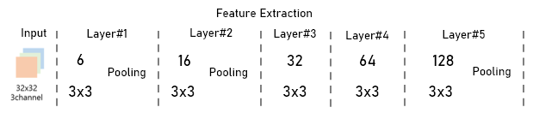
CNN – Number of Layers
Estimate Best Performance Network (AddThreeLayerNet)
Results
BasicNet | AddOneLayerNet | AddTwoLayerNet | AddThreeLayerNet
60% | 64% | 66% | 62%

Slide 7
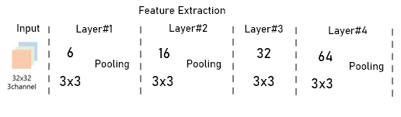
CNN – Number of Layers
Results
Not necessarily a lot of layers have a good performance

Slide 8
CNN – Dropout
Hypothesis
Dropout will help decrese loss between train and test
> Prevent Overfitting
Experiment
NoneDropoutNet | AddDropoutNet
Same as AddTwoLayerNet | Add Dropout Layer#4 Dropout (0.5)

Slide 9
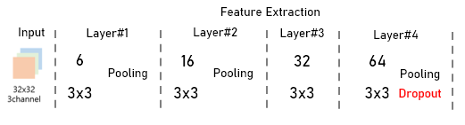
CNN – Dropout
Estimate Best Performance Network (AddDropoutNet)
Results
NoneDropoutNet | AddDropoutNet
66% | 65%

Slide 10
CNN – AlphaLayer
Through the previous results, a lot of layer doesn’t guarantee good performance
Hypothesis
Adding feature that similar origin image to output feature will help improve performance
Replenish lost information

Slide 11
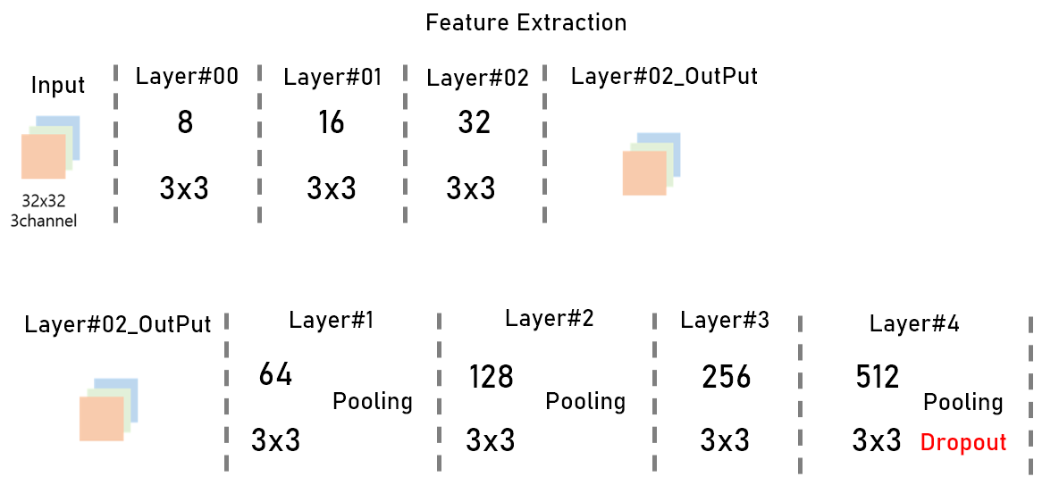
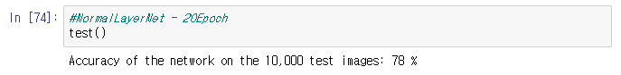
CNN – AlphaLayer
NormalLayerNet

Slide 12
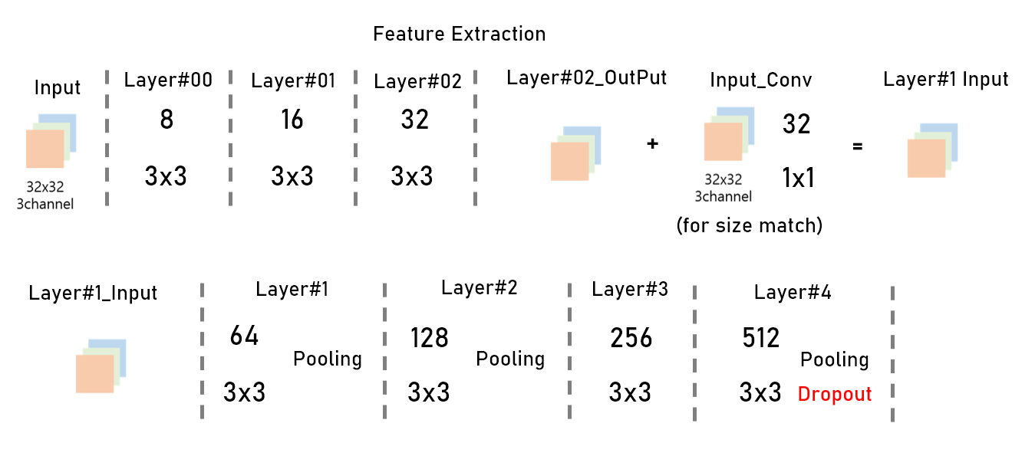
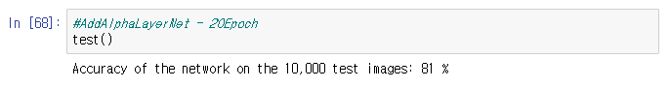
CNN – AlphaLayer
AddAlphaLayerNet

Slide 13
CNN – AlphaLayer
Results
NormalLayerNet | AddAlphaLayerNet
78% | 81%
But really?

Slide 14
Intermediate Feature Space
NormalLayerNet
AddAlphaLayerNet
How are the feature maps different?
Key Difference

Slide 15
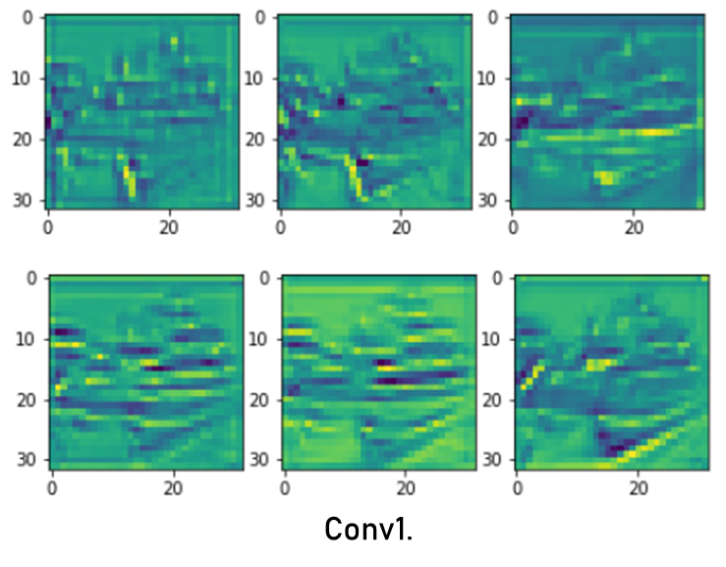
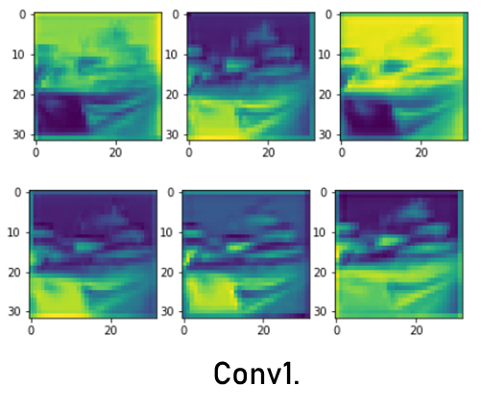
Intermediate Feature Space
NormalLayerNet
AddAlphaLayerNet

Slide 16
Intermediate Feature Space
NormalLayerNet
AddAlphaLayerNet

Slide 17


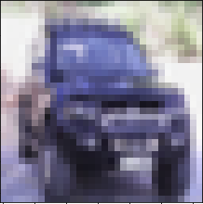
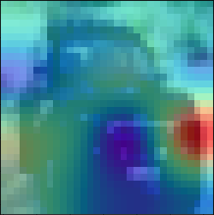
CAM
NormalLayerNet

Slide 18


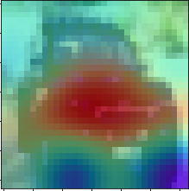
CAM
AddAlphaLayerNet

Slide 19




CAM
NormalLayerNet

Slide 20


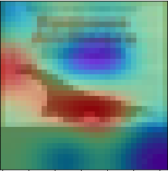
CAM
AddAlphaLayerNet

Slide 21
CAM
NormalLayerNet
AddAlphaLayerNet
NormalLayerNet
AddAlphaLayerNet

Slide 22
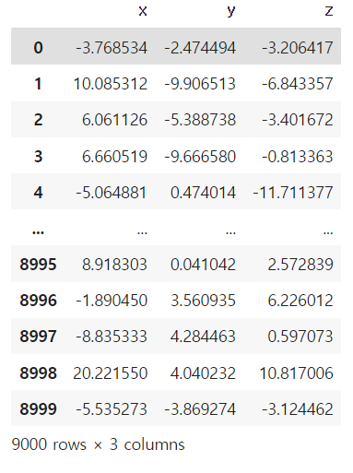
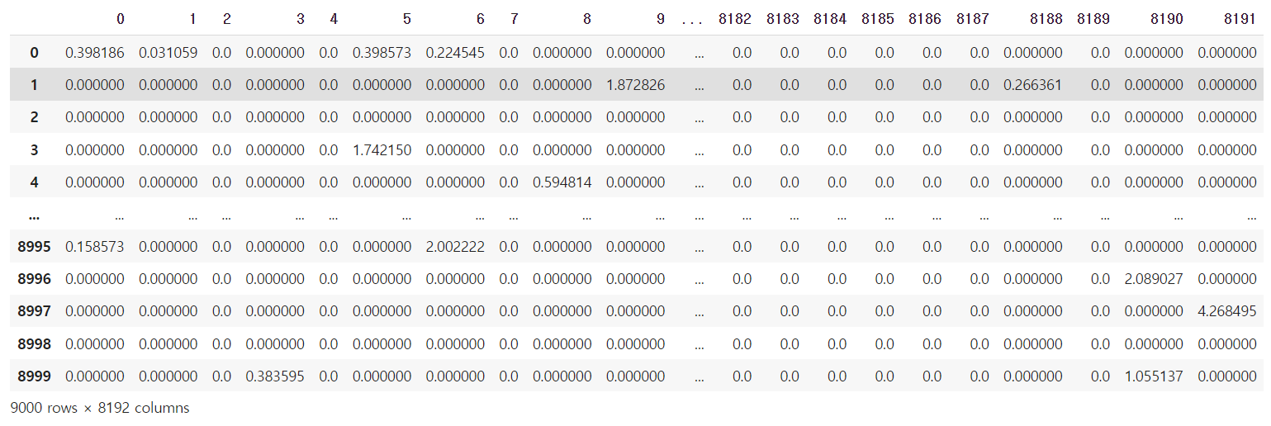
EM Algorithm
차원 축소(PCA)

Slide 23
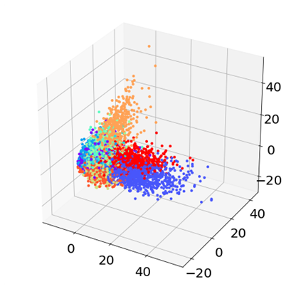
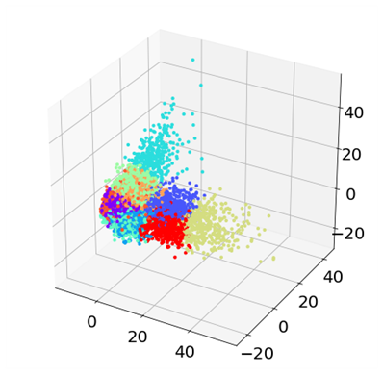
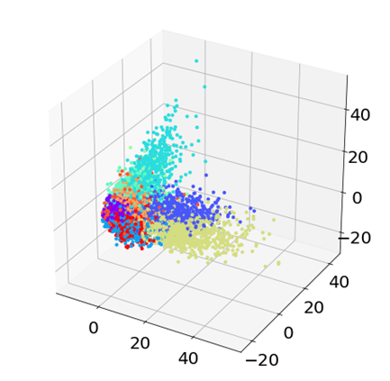
EM Algorithm
<label>
<K-means>
<GMM>

Slide 24
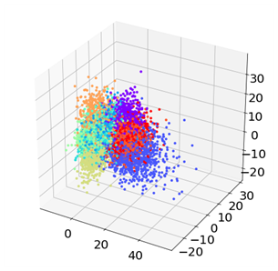
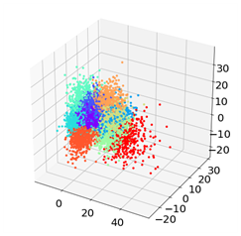
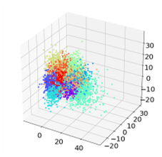
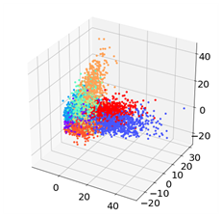
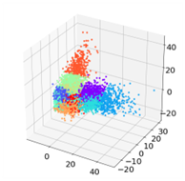
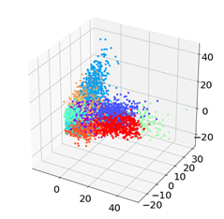
EM Algorithm
Cross Entropy + 0.5
<label>
<K-means>
<GMM>
Cross Entropy - 0.5
<label>
<K-means>
<GMM>

Slide 25
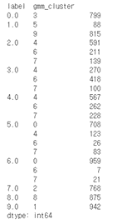
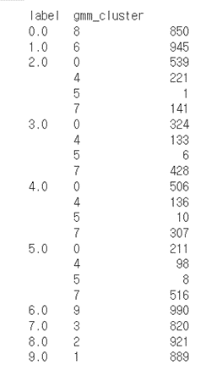
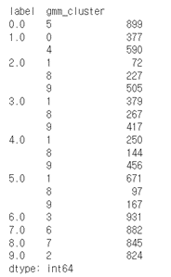
EM Algorithm
<Cross Entropy>
<Cross Entropy + 0.5>
<Cross Entropy - 0.5>

